Slide 1


Analyzing eCommerce Business Performance with SQL
Created by:
Yanyan Gatot Mulyadi
yanyangatot1059@gmail.com
https://www.linkedin.com/in/yanyan-gatot-348619177/
As a business graduate with a keen interest in data analysis, I possess a strong foundation in market research and SQL. I am adept at leveraging data to uncover valuable insights and develop impactful marketing campaigns. With a curious and innovative mindset, I constantly explore new ways to harness the power of data to drive business performance. My expertise in SQL allows me to efficiently manage and analyze large datasets, enabling data-driven decision-making. I am passionate about staying abreast of industry trends and leveraging data to achieve marketing success and deliver tangible results.

Slide 2
Overview
“Dalam suatu perusahaan mengukur performa bisnis sangatlah penting untuk melacak, memantau, dan menilai keberhasilan atau kegagalan dari berbagai proses bisnis. Oleh karena itu, dalam paper ini akan menganalisa performa bisnis untuk sebuah perusahan eCommerce, dengan memperhitungkan beberapa metrik bisnis yaitu pertumbuhan pelanggan, kualitas produk, dan tipe pembayaran.”

Slide 3
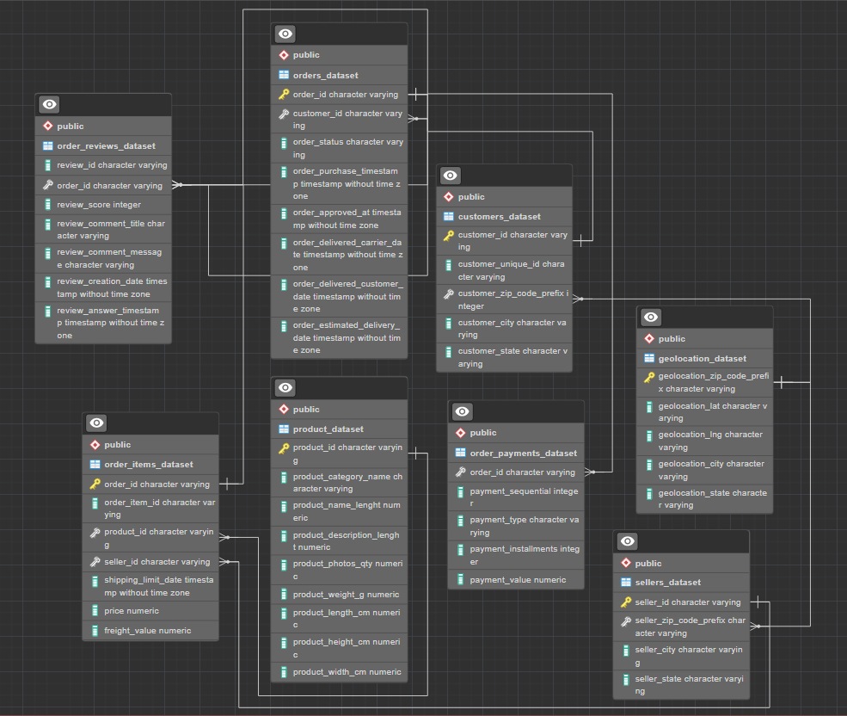
Data Preprocessing
In this task, I created an ERD for a Analyzing eCommerce Business Performance. The ERD is a useful tool for designing and documenting database systems. It can help to ensure that the database is well-structured and that the data is properly organized.
I created the ERD using the following steps:
I identified the entities in the system.
I identified the attributes of each entity.
I identified the relationships between the entities.
I drew the ERD.

Slide 4
Data Preprocessing
The following is a step-by-step summary of how I created the ERD:
I first identified the entities in the system, which are order_reviews_dataset, orders_dataset, customers_dataset, geolocation_dataset, sellers_dataset, order_payments_dataset, product_dataset, order_items_dataset.
I then identified the attributes of each entity. For example, the orders_dataset entity has the order_id, customer_id.
I then identified the relationships between the entities. For example, a orders_id can place an order_id, and customer_id can have one or more Products.
I finally drew the ERD, using the following information
Download ERD here

